Slide 1
Camunda Platform 8
Code Studio
hosted by your favorite Developer Advocates
Notes:
Intro/Logistics (5 min)
Quick self-intro & introduction of other Camundos (consultants + advocates)
What's the workshop about?
expectation - overview of scenario, challenges, and goal
structure/agenda - what to expect timing-wise (including breaks, etc.)
breakout sessions - how to raise hand, contact us, etc.

Slide 2


Your hosts for this session
Thomas Heinrichs
Developer Advocate
Josh Wulf
Developer Advocate

Slide 3
Welcome and Introduction
What is Camunda Platform 8?
Designing a Process
Break
Discover Camunda 8
Designing a first draft with User Tasks and Forms
Automating the process by implementing a client
Break
Analysing the process using Optimize
Conclusion
Hangout & Beer
End

Slide 4




Useful Links
GitHub Repository: Camunda-8 Code Studio
https://github.com/camunda-community-hub/camunda-8-code-studio
Camunda Platform 8 Documentation
https://docs.camunda.io/
Slides
https://docs.google.com/presentation/d/1cunSqK-OBmFVwxRGxnU43wXDiWkACnLk0ox9Wu8Wixs/edit?usp=sharing
Camunda Platform 8 SaaS Sign-up
https://accounts.cloud.camunda.io/signup

Slide 5
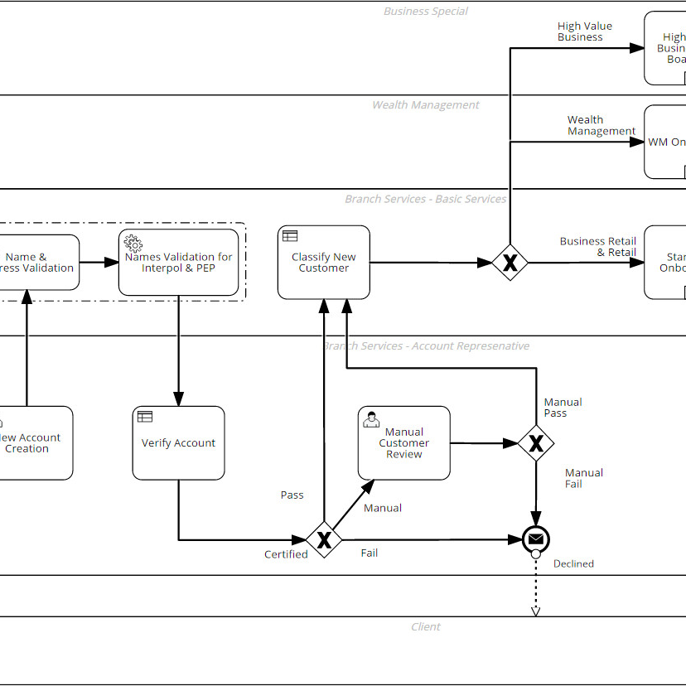


What to expect
Applying Modelling Standards
Get-started with Camunda 8
Learn how to use BPMN and DMN to model processes and decisions
Get some first hands-on experience and learn how to get started quickly.
Implementing Service Tasks
Save the World
Learn how to implement a Service Task in a programming language of your choice
By designing and automating the process for our given use-case.

Slide 6


Scenario Description
The Hypothetical Zombie Virus (HZV) strikes again!
Infections are rising
Infections are rising. We somehow need to avoid this with a quarantine!
In a parallel universe humankind is facing the thread of HZV which can turn humans into zombies.
Of course the health departments are equipped badly and it takes too long to notify people to quarantine.
Goal: Help the health department to scale their quarantine process
Biohazard Alert
It is our task to save the world from destruction using the power of Process Automation.
Time crucial
We need a solution in time which is more efficient than working with excel files.

Slide 7
About Camunda
2008
300+
100,000+
Founded
Employees Globally
Community Members
6
500+
190+
Offices Worldwide:
America, Asia, and Europe
Enterprise Customers
Countries with people using Camunda
Notes:
What is Camunda Platform 8? (10 min)
overview of product
quick overview of components
quick overview of differences between C7 / C8
differences in terminology

Slide 8
Common Camunda Uses
Top uses of Camunda across three areas of work
IT Initiatives
Technical Use Cases
Business Processes
Building a centralized process automation platform
Replacing a legacy business process management (BPM) suite
Replacing homegrown workflow technology
Moving applications to the cloud
Human workflow automation
Microservices orchestration
RPA bot orchestration
Decision automation
Document management
Customer onboarding and data management
Order management
Claims management
Loan origination
Risk management and underwriting

Slide 9














Code + deploy in your preferred language and tooling.
Run on your preferred platforms.
Across all endpoints.
Human Work
AI
Business Rules
Microservices
RPA
API
IoT

Slide 10

Camunda Platform 7: The Universal Process Orchestrator
Design
Automate
Improve
Developers & business users collaborate to design & deploy processes with Camunda.
Enterprise-grade automation platform. Built for today’s business complexity, loved by developers.
Operations teams access the insights needed to improve processes.
Modeler
Model & deploy business process diagrams with BPMN & DMN.
Available via web and desktop app.
Workflow Engine
Automate and orchestrate mission-critical business processes via BPMN.
Optimize
Get the insights you need to understand and continuously improve your business processes.
Decision Engine
Align IT and the business to automate decisions and orchestrate them as part of end-to-end business processes via DMN.
Forms
Drag & drop creation of forms that power workflows that require human interaction.
Tasklist
Assign and execute tasks that require human interaction via easy-to-use Forms or via your own apps with the Tasklist API.
Cockpit
Real time visibility to monitor, analyze and resolve problems with any process instance.

Slide 11
Camunda Platform 8: The Universal Process Orchestrator
Design
Automate
Improve
Developers & business users collaborate to design, connect & deploy processes with Camunda.
Enterprise-grade automation platform. Built for today’s business complexity, loved by developers.
Operations teams access the insights needed to improve processes.
Modeler
Model & deploy business process diagrams with BPMN & DMN.
Available via web and desktop app.
Zeebe
Next-generation cloud-native workflow engine that unlocks unparalleled speed, scale & resilience. Open source SDKs in your preferred programming language brings the extensibility you need for your complex business processes.
Optimize
Get the insights you need to understand and continuously improve your business processes.
Tasklist
Assign and execute tasks that require human interaction via easy-to-use Forms or via your own apps with the Tasklist API.
Connectors
Integration Framework
Forms
Operate
Real-time visibility to monitor, analyze and resolve problems with any process instance.
Out-of-the-box integrations to easily communicate with popular enterprise applications & protocols.
Build & provision your own connectors to any system including homegrown & legacy applications.
Drag & drop creation of forms that power workflows that require human interaction.

Slide 12
Camunda Advantage
Traditional Approach
Camunda Approach
Fragmented Processes
End-to-End Orchestration
Proprietary
Standards-based Collaboration
Tough to Install & Extend
Developer-friendly
Blackbox Monoliths
Open Architecture
Endless Expense & Maintenance
Cost-Effective

Slide 13



































Customers we’ve helped
Financial Services
Insurance
Telecom
Media
Transport & Logistics
Technology
Manufacturing
Public Sector

Slide 14
Hands-on Part
Exercises for the Code Studio

Slide 15
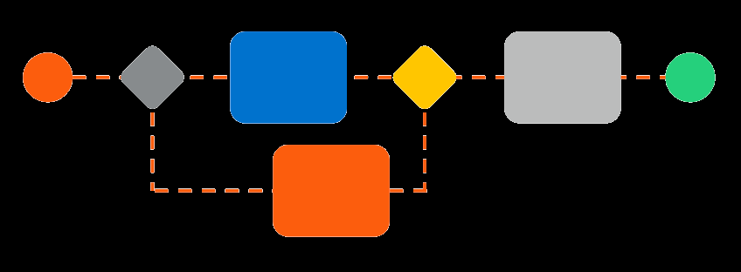
Design the process!
Notes:
Exercise 1 (60 min total)
Introduction (15 min)
more in-depth scenario explanation (including process model)
outline the business problem + why automation is necessary
intro to web modeler
give people links
GitHub repo
documentation for modeling with BPMN & DMN
introduce exercise & expected end result
introduce breakout rooms (reiterate how to get help) and state how long they'll be open
Randomized Breakout Rooms (30 min)
Summarize / Discuss Solutions (15 min)
call on attendees to share
present ideal solution

Slide 16

Get familiar with Camunda 8
Notes:
Exercise 2 + Break (25 min total)
Introduction (15 min)
show how to create a cluster and ask them to start the process
switch to demo cluster and step through each component, showing each quickly (what they look like)
Break -- If issues, join Breakout Rooms (10 min)
breakout rooms will be self-select -- NOT randomized for this session

Slide 17

Join at menti.com
Code:
Notes:
Quiz (10 min)

Slide 18
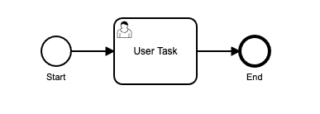
Design a process with User Tasks and Forms
Notes:
Exercise 3 (total 30 min)
Introduction (10 min)
more in-depth description of how to create Forms
show how to deploy a process model with Forms
show how to run the process
introduce exercise & expected end result
introduce breakout rooms (reiterate how to get help) and state how long they'll be open
Randomized Breakout Rooms (20 min)

Slide 19
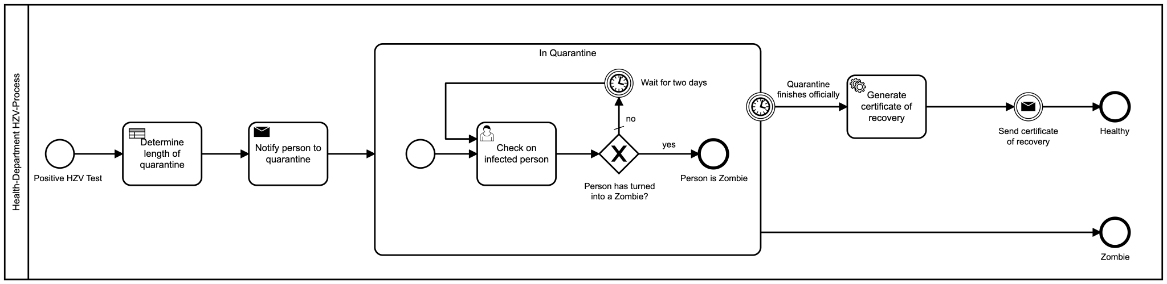
Automating the process by implementing a client
Notes:
Exercise 4 (60 min total)
Introduction (15 min)
present final process model (recap)
elaborate on what different clients they can use and where they can find solutions (documentation, etc.)
code snippets from 1-2 clients max (let people vote? or most comfortable)
demonstrate how to set up using example that's already created
mention connectors as a bonus exercise (link to documentation)
introduce exercise & expected end result
introduce breakout rooms (reiterate how to get help) and state how long they'll be open
if we have named rooms (instead of randomized), ask attendees to choose the most appropriate room
Code-specific Breakout Rooms (30min)
Summarize / Discuss Solutions (15 min)
live demo of our process (end-to-end overview with all components)
call on attendees to share
Break -- If issues, join Breakout Rooms (10 min)
breakout rooms will be self-select -- NOT randomized for this session

Slide 20
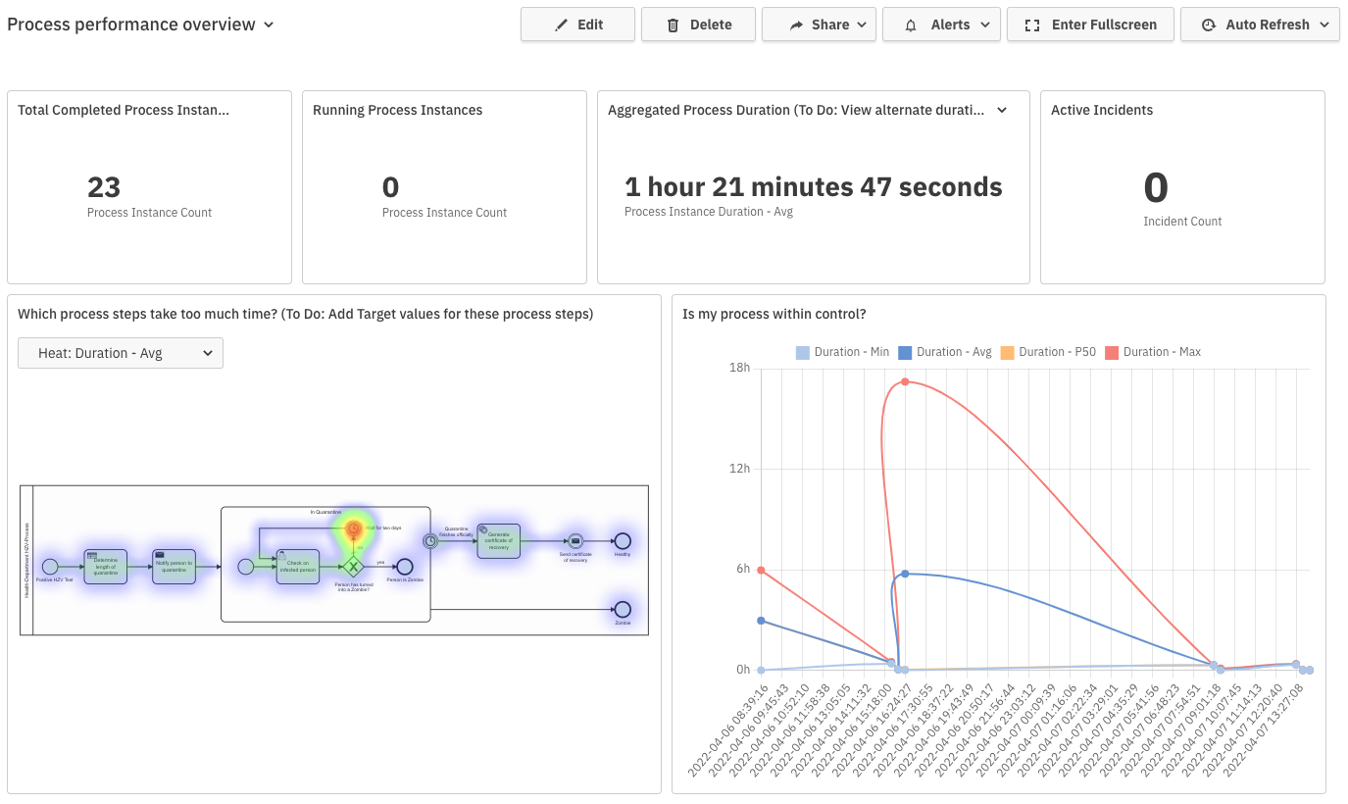
Analysing the Process using Optimize
Notes:
Exercise 5 (55 min total)
Introduction (10 min)
deeper dive into Optimize
how to create a report, dashboard, etc.
introduce exercise & expected end result - run each process several times and close them down each time
introduce breakout rooms (reiterate how to get help) and state how long they'll be open
(optional) point people to additional showrooms if they want to see other examples
Breakout Rooms (30min)
Summarize / Discuss Solutions (15 min)
call on attendees to share
present our solution/reports

Slide 21

Now you have earned yourself a Beer
Leave some Feedback!
Well done and thanks a lot for participating in this workshop!
Notes:
Conclusion (10 min)
recap what we've learned
point people back to GitHub for additional information from the repo if they want to revisit the exercises
point people to Slack/forum for future questions or to engage with us further
point people to Slido for feedback (https://app.sli.do/event/aTr7YWkoJaGo2fbLxcKnve/embed/polls/b83e09e9-92ed-4820-9f13-4798b3beWhat 6781)

